Slide 1
Project Quality Management

Slide 2
Quality Management
Project Quality Management includes the processes and activities of the performing organization that determine quality policies, objectives, and responsibilities so that the project will satisfy the needs for which it was undertaken.
Project Quality Management works to ensure that the project requirements, including product requirements, are met and validated.

Slide 3
Quality Management
The three main processes in the Quality Management Knowledge Area are:
1. Plan Quality Management: The process of identifying quality requirements and/or standards for the project and its deliverables, and documenting how the project will demonstrate compliance with quality requirements and/ or standards.
2. Manage Quality (formerly called Perform Quality Assurance): The process of translating the quality management plan into executable quality activities that incorporate the organization’s quality policies into the project.
3. Control Quality: Monitoring and recording the results of executing quality activities to assess performance and recommend necessary changes.

Slide 4
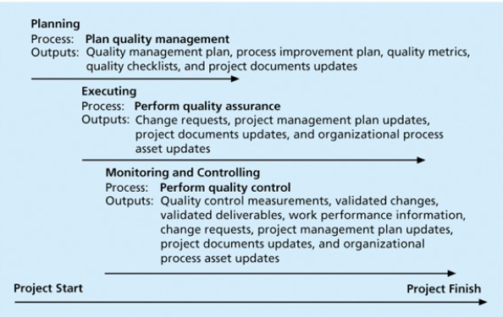

Slide 5
Plan Quality Management
Plan Quality Management: The process of identifying quality requirements and standards for the project and its deliverables, and documenting how the project will demonstrate compliance with quality requirements and standards.
What is the quality for this project? How will we ensure it?
The key benefit of this process is that it provides guidance and direction on how quality will be managed and veriﬁed throughout the project.

Slide 6
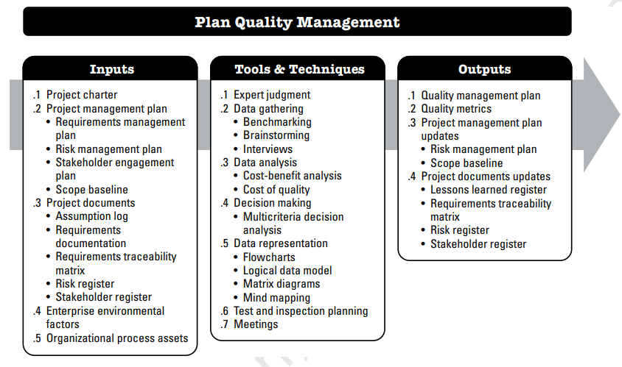

Slide 7
PLAN QUALITY MANAGEMENT: TOOLS AND TECHNIQUES
DATA ANALYSIS:
Cost Benefit Analysis: A cost-beneﬁt analysis is a ﬁnancial analysis tool.
The main reason behind maintaining quality is to have less rework, lower cost, higher productivity, and higher customer satisfaction.
In cost-benefit analysis, we compare benefits versus the cost of meeting quality requirements.

Slide 8
PLAN QUALITY MANAGEMENT: TOOLS AND TECHNIQUES
Cost of quality. The cost of quality (COQ) associated with a project consists of one or more of the following costs
Prevention costs. Costs related to the prevention of poor quality in the products, deliverables, or services of the speciﬁc project…Quality Planning.
Appraisal costs. Costs related to evaluating, measuring, auditing, and testing the products, deliverables, or services of the speciﬁc project.
Failure costs (internal/external). Costs related to non-conformance of the products, deliverables, or services to the needs or expectations of the stakeholders.
Internal Cost: It occurs when an error is detected in a product before shipment, Including rework, repair, and failure mode analysis.
External Failure cost: Involves defects found after the product has been shipped. Include complaint resolution, product return, and replacement, helpline support, and warranty work

Slide 9
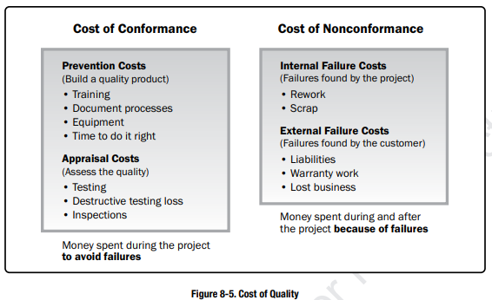
Cost of Quality

Slide 10
Plan Quality Management: Tools And Techniques
Data Representation:
Data representation techniques that can be used for this process include but are not limited to:
Flowcharts. Also called Process maps, because flow charts describe the sequence of steps. The flow charts help us better understand projects. SIPOC (suppliers, inputs, process, outputs, and customers) model. SIPOC is a method for describing and improving processes by summarizing the inputs and outputs of one or more processes.
Matrix diagrams. The matrix diagram shows the relationship between two, three, or four groups of information. It is used to analyze and determine the relationship between data sets.

Slide 11
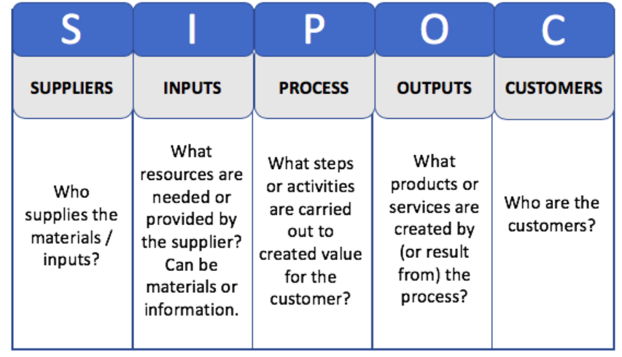

Slide 12
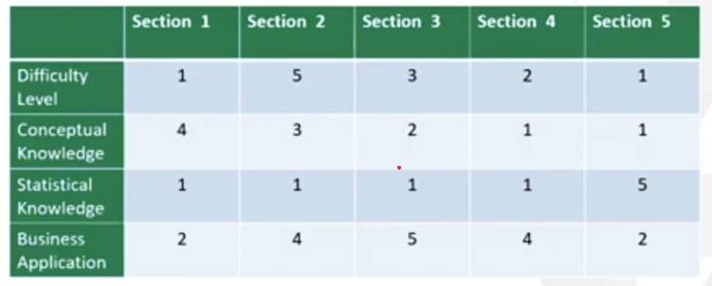
Matrix Diagram – L Shaped

Slide 13
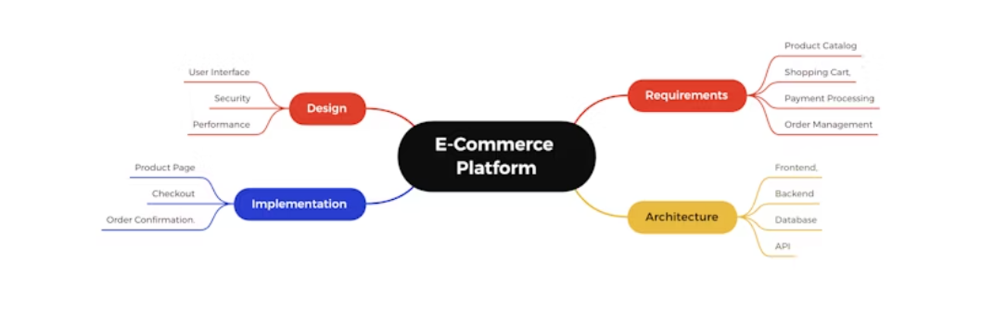
PLAN QUALITY MANAGEMENT: TOOLS AND TECHNIQUES
Mind mapping. Mind mapping is a diagrammatic method used to organize information visually.

Slide 14
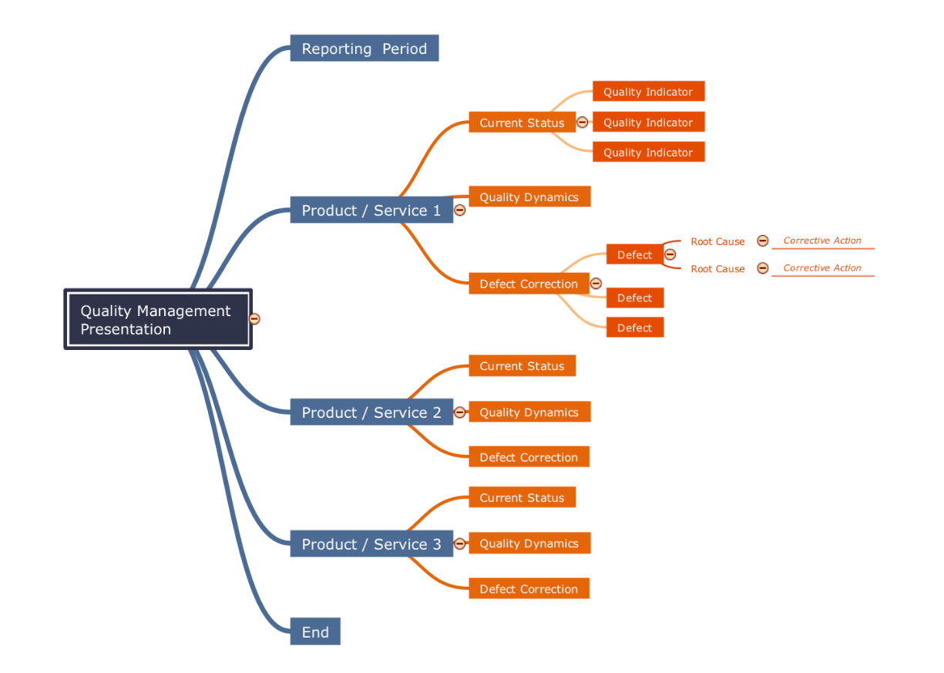

Slide 15
PLAN QUALITY MANAGEMENT: OUTPUTS
1 Quality Management Plan
The quality management plan may include but is not limited to the following components:
1. Quality standards that will be used by the project
2. Quality objectives of the project
3. Quality roles and responsibilities.
4. Project deliverables and processes are subject to quality review.
5. Quality control and quality management activities planned for the project
6. Quality tools that will be used for the project.

Slide 16
PLAN QUALITY MANAGEMENT: OUTPUTS
2 Quality Metrics
Some examples of quality metrics include the percentage of tasks completed on time, cost performance, failure rate, and number of defects identified per day,...
3 Project Management Plan Updates: Risk Management plan and scope baseline.
4 Project Documents Updates: Lessons learned register, Requirements traceability matrix, Risk register, and Stakeholder register.

Slide 17
Manage Quality
Manage Quality is the process of translating the quality management plan into executable quality activities.
The key benefits of this process
Increases the probability of meeting the quality objectives.
Identifying ineffective processes and causes of poor quality.

Slide 18
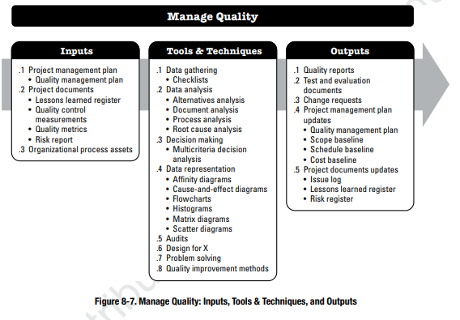
Manage Quality

Slide 19
Manage Quality: Tools And Techniques
Root cause analysis (RCA). analytical technique used to determine the basic underlying reason that causes a variance, defect, or risk.
DATA REPRESENTATION
Affinity diagrams. A diagram reflecting an affinity (connection) among information sets.
Cause-and-effect diagrams. This type of diagram breaks down the causes of the problem statement into discrete branches, helping to identify the main or root cause of the problem. It is used to find possible causes of problems.
Flowcharts. Flowcharts show a series of steps that lead to a defect.

Slide 20
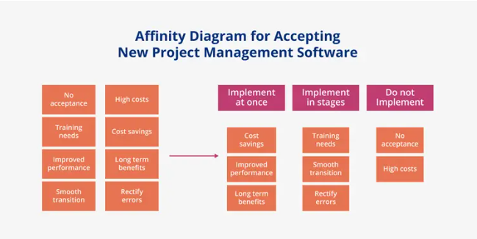

Slide 21
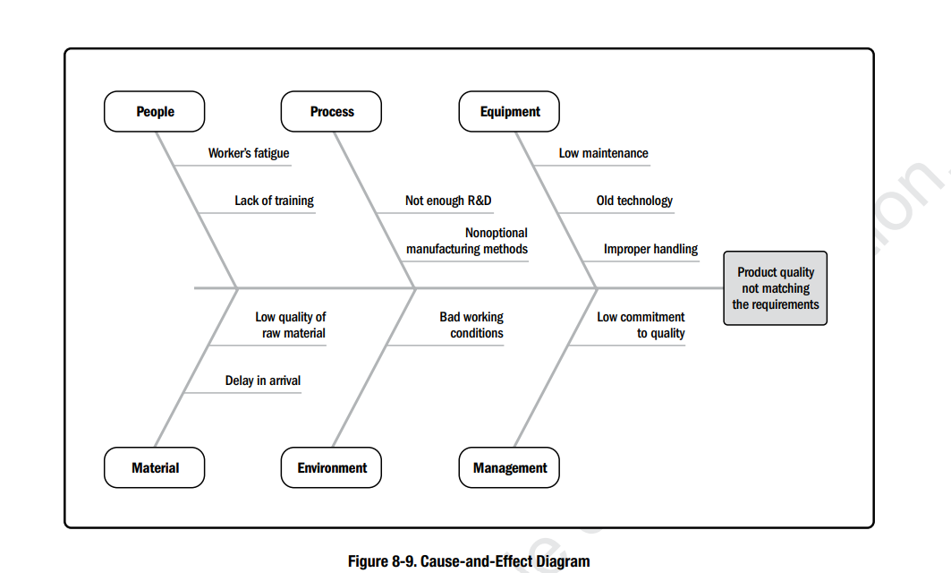

Slide 22
Manage Quality: Tools And Techniques
Problem Solving:
Problem-solving methods generally include the following elements:
Deﬁning the problem,
identifying the root cause.
generating possible solutions.
choosing the best solution.
implementing the solution, and
Verifying solution effectiveness.

Slide 23
Manage Quality: Outputs
Quality Reports: The information may include
Quality management issues, recommendations for process, project, and product improvement, corrective action recommendations, and the summary of ﬁndings from the Control Quality process.

Slide 24
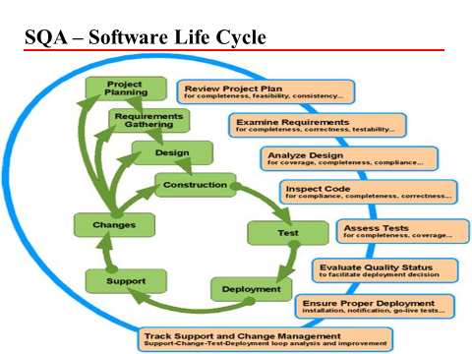

Slide 25
Control Quality
Control Quality is the process of monitoring and recording results of quality management activities to assess performance and ensure the project outputs are complete, correct, and meet customer expectations.
The key benefit of this process is verifying that project deliverables and work meet the requirements speciﬁed by key stakeholders for ﬁnal acceptance.

Slide 26
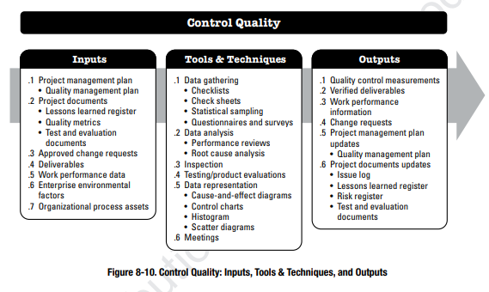
Control Quality

Slide 27
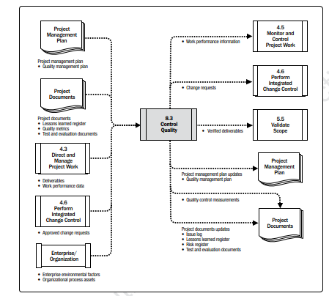

Slide 28
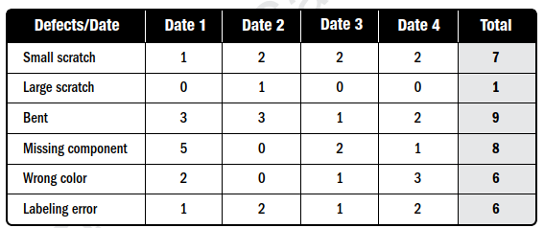
Control Quality: Tools And Techniques
Data Gathering Techniques
Check sheets. Check sheets are used to collect data about a problem or its attributes when performing inspections.

Slide 29
Control Quality: Tools And Techniques
Questionnaires and Surveys. Surveys may be used to gather data about customer satisfaction after the deployment of the product or service.
Inspection: An inspection is the examination of a work product to determine if it conforms to documented standards.
The results of a single activity can be inspected, or the ﬁnal product of the project can be inspected. Inspections also are used to verify defect repairs.

Slide 30
Control Quality: Outputs
1 Quality Control Measurements are the documented results of Control Quality activities.
2 Verified Deliverables: The results of performing the Control Quality process are veriﬁed deliverables that become an input to the Validate Scope process.
The other outputs are Work Performance information, Change requests, and project management plan & document updates.

Slide 31
Reading Assignment
Chapter 8: Project Quality Management by PMBOK-Guide-5th-Edition-PMI

